Slide 1
Entra Permissions Management Executive Summary
Quantium

Slide 2
Agenda
Introduction to EPM (10 mins)
Findings from Risk Assessment (15 mins)
Commercial
Next steps

Slide 3
Introdution
Notes:
[Talk Track]
Let’s talk about achieving Least privilege for the identities. Primary means of achieving that is by running regular access reviews, which you currently use Azure AD access reviews for. If you look at regulatory metrices for reviews, some of the important things to ensure completeness of access reviews are:
Frequency - Regular reviews multiple reviews (feedback)
Scope – Completeness. Decision owned by information asset owner
Completeness - Metrics – review access [by role, privilege, ageing, coverage%)
[Click] The organisations use tools like SailPoint or Saviynt or Azure AD Access Review.
[Click] This mainly covers membership validation.
[Click] Similarly, when elevated permissions are needed for administrative tasks, it’s recommended to provision that JIT.
[Click] This is done using PAM process with tools like CyberArk or Azure AD PIM.
Notice that this is still about ensuring right membership to elevated roles or groups, or access to a session created with an identity that has these roles or groups.
[Click] However it still leaves the risk of these roles providing more permissions than the given identities need for the job.
[Click] That’s where an Entitlement Management solution like EPM comes in to help Discover where the roles are provisioned with more permissions than needed, and remediate the extra permissions from those roles.
** sidenote – Presence of these IGA/ PAM tools is very common in ANZ. And we do not compete with them with EPM, but play together.

Slide 4
Findings from Risk Assessment

Slide 5
Discover and Measure
Objective | Provide Quick, Comprehensive visibility to information that can be used to improve access certification.
User and Machine Identities
Trend monitoring
Summary:
X Subscriptions
X Average Permission Creep Index (PCI)
X % Inactive users, 97% Inactive SP
X Over provisioned identities
X% Access rate for resources (avg)
Summary at-a-glance for monitoring
Notes:
PAM
Enforce priv access – Enforcing role based provisioning, Request / Approal for access elevation, POD
Session management - Cred vault, auth brokering, session recording
Entitlement Management
1. Permission analytics
2. Role templating, recommendation
3. Role right-sizing
CSPM (IAM space)
Policy based assess evaluation and enforcement
Compliance support and access recommendation

Slide 6
Investigate
Over Permission (Groups)
Objective | Investigate and Prioritise remediation based on rich insights about permissions usage
x inactive groups.
x over-provisioned members.
Max PCI x
Notes:
There are multiple ways to slice this information
Identity view – prioritise critical identities and service principals
Group view – Easier to remediate at group level. Helps consolidate
Resource view – Usage trend and permission map
<Click>

Slide 7
Investigate
Inactive Identities
Objective | Investigate and Prioritise remediation based on rich insights about permissions usage
> X Inactive Users
> X Inactive Machine Identities
.Infrequent users / Service provides / Out-of-life apps

Slide 8
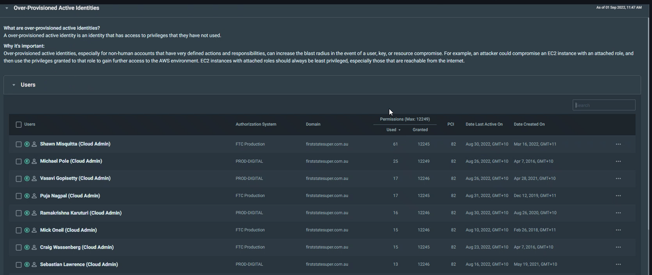
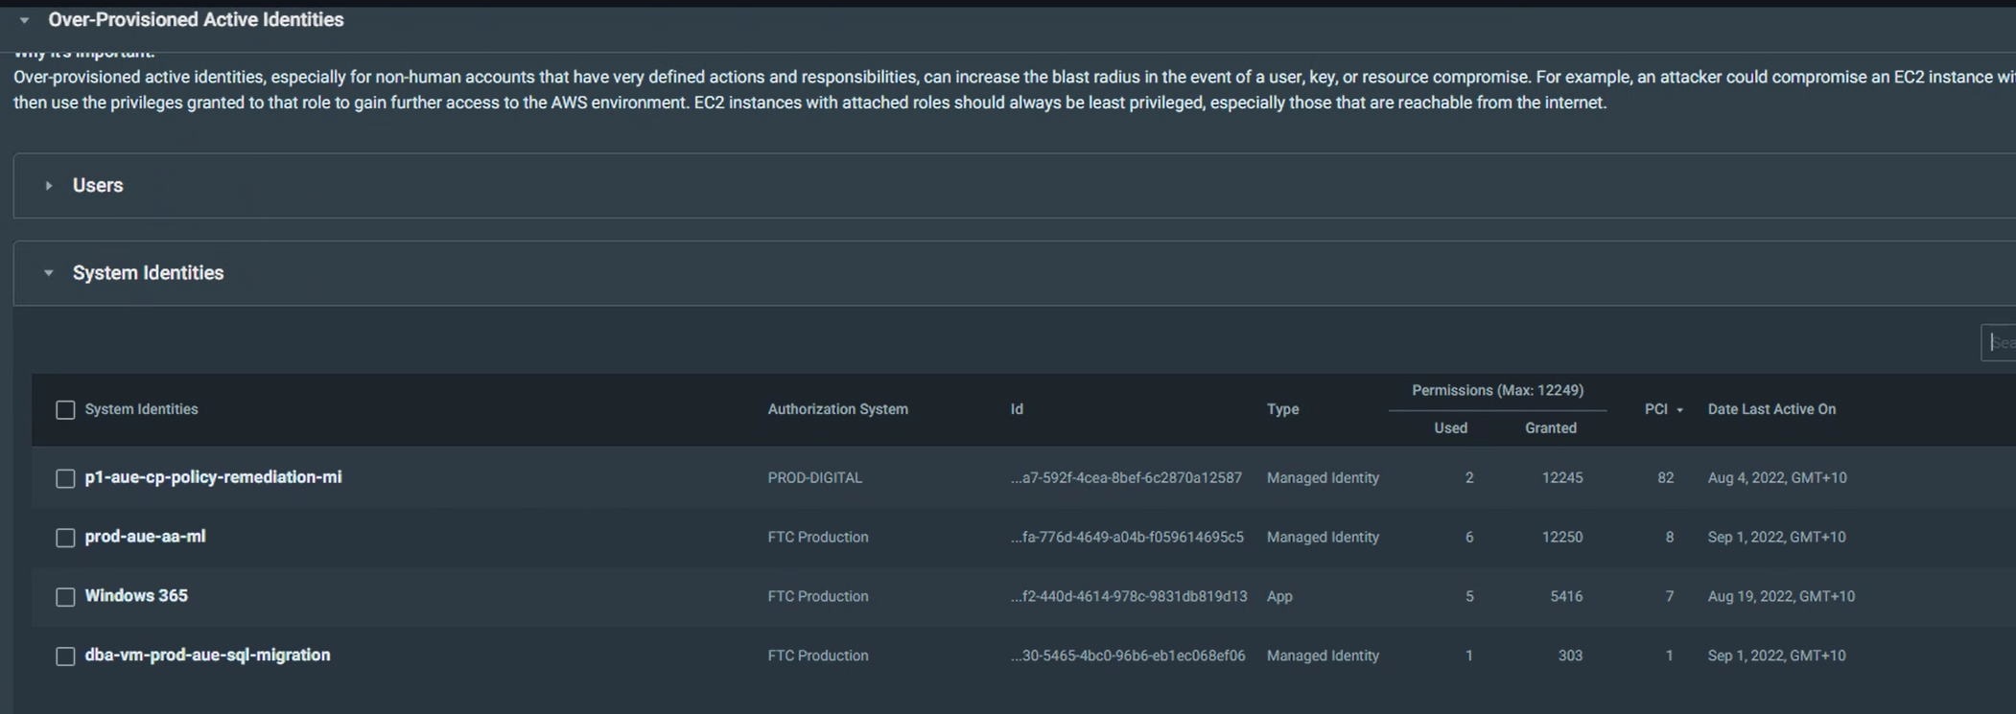
Investigate
Over Provisioned Identities
Objective | Investigate and Prioritise remediation based on rich insights about permissions usage
x Users with over-provisioned access
Max PCI = X
Access to A – B resources
High PCI since at least Z weeks.
Multiple group memberships (Contributing to Group PCI)

Slide 9
Investigate – Resource View
Objective | Review Resource Usage and permissions mapping to prioriitise critical assets

Slide 10
Remediate
Objective | Easily Remediate over-provisioned access by using insights Evidence of actual usage trend
Easy to use automation to create custom roles based on activity of users, groups or roles. Create custom policies with single click from CloudKnox console or download scripts to create it offline
Notes:
Remediation is a process of creating right-sized roles that provide access to these groups and identities.

Slide 11
Permissions On Demand
Objective | Provision High-Risk / Out of Band permissions on demand.

